Slide 1
System Programming
09:10-12:00 Friday
T3-119

Slide 2
Instructor
  Quincy Wu (吳坤熹), solomon@ipv6.club.tw
Textbook
  Leland L. Beck, "System Software: An Introduction to Systems Programming" (3rd Edition), published by Addison Wesley.
Requirements
  Homework x3 30% (do not copy)
  Mid-term exam 30%
  Oral presentation 20%
  Final exam 20%
Course Webpage
  http://solomon.ipv6.club.tw/Course/SP/
TAs

Slide 3
Goals of This Class
Enforce your programming skill
Get you acquainted with programming tools on Unix
Make you prepared for graduate school entrance exams

Slide 4
Introduction
Software
  Application software usually used by end-user
    It is concerned with the solution of some problem, using the computer as a tool, instead of how computers actually work.
  System software
    System software consists of a variety of programs that support the operation of a computer (ex: text editor, compiler, debugger)
    One characteristic in which most system software differ from application software is machine dependency
    A system software programmer must know the target machine structure

Slide 5
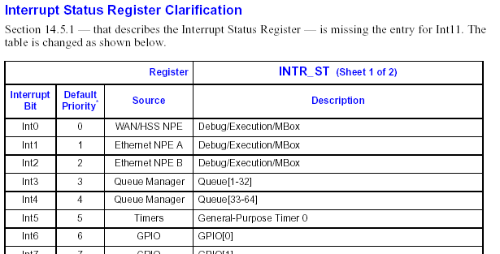
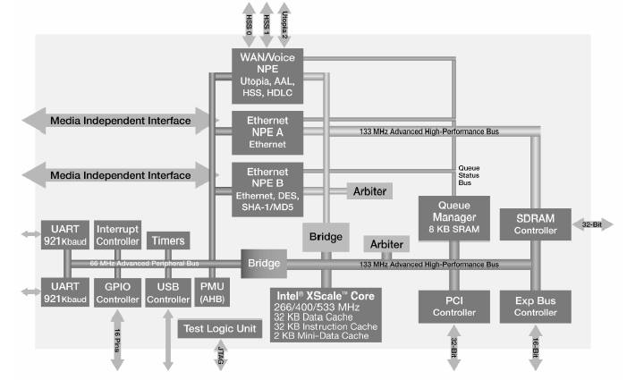
Target Machine Example

Slide 6
Basic Features and Design Options
Fundamental features
  Basic functions and characteristics should remain essentially the same, regardless of what machine is being used.
Major design options
  There is no single “right” way of doing things; a software designer needs to be aware of the available options in order to make intelligent decisions

Slide 7
System Software and Machine Architecture
Machine dependent system software
  System programs are to support the operation and use of the target computer.
  The difference between different machine
    Machine code
    Instruction formats
    Addressing mode
    Registers
Machine independent system software
  General design and logic is basically the same:
    Code optimization
    General design and logic of an assembler

Slide 8
System Software
The system software includes
  Assembler
  Linker
  Loader
  Macro processor
  Text editor
  Compiler
  Operating system
  Debugging system
  Source Code Control System
  (optional) Database Management System

